Slide 1
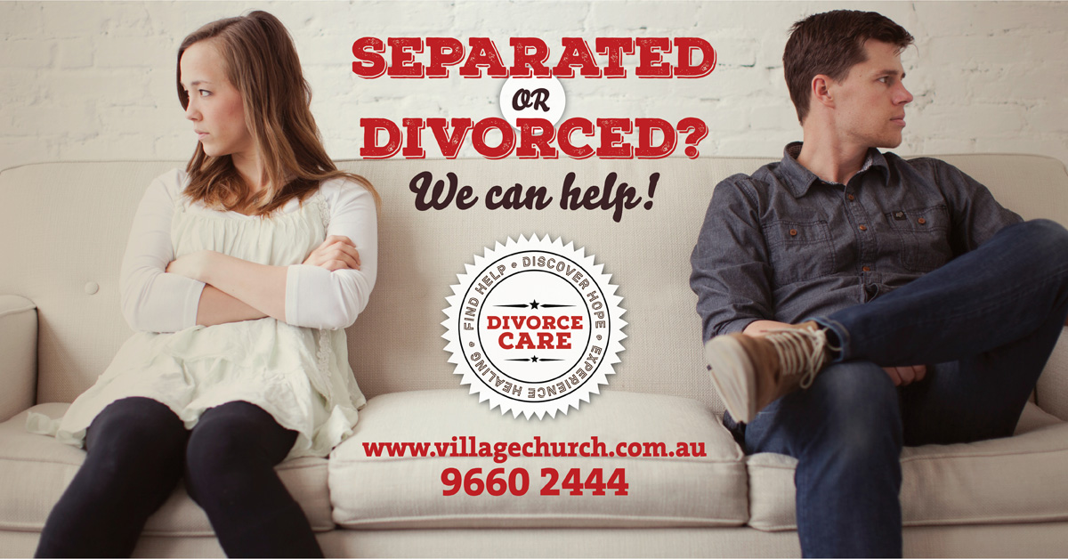

Slide 2
Dominic Steele, Pastor, Village Church, Annandale
Introduction
Running Divorce Care at Village Church: - The history - The aim - The impact

Slide 3
Michael Sheedy and Melinda Hunt, Divorce Care Group Leaders
Matthew 9
³⁷ Then [Jesus] said to his disciples, “The harvest is plentiful but the workers are few. ³⁸ Ask the Lord of the harvest, therefore, to send out workers into his harvest field.”

Slide 4
Some feedback
I didn't know what to expect when I signed up for for Divorce Care. I imagined it would be awkward and difficult and that I would not say a thing because who in their right mind shares personal, intimate things about their brokenness with strangers. You had to be desperate or nuts to do that. As it turned out I must have been both desperate and nuts as I think I have become a regular sharer.
Divorce care is the high point in my calendar, Melinda and Mike are friendly, easy going and genuinely caring. Divorce care helped me heal and gave me a new perspective. Try it, what have you got to lose.
Female, 50, Inner West

Slide 5
Some feedback
Divorce is difficult, divisive and draining! Attending the Divorce Care course with our sensitive facilitators and other people going through similar situations gave me the strength and skills to navigate this time in my life.
I pray more churches in the Diocese would implement the Divorce Care course to support and encourage those who find their marriages breaking down.
I also think churches should be running courses for Marriage Enrichment, Better Communication and Parenting as a priority, which may help lessen the need for divorce courses.
Female, 56, South Western suburbs

Slide 6
Michael Sheedy and Melinda Hunt, Divorce Care Group Leaders
Elective outline
What is Divorce Care?
Why run Divorce Care?
How to run Divorce Care?
Other things to consider
Resources
Question time
The Divorce Care course was transformative. From the first meeting, I no longer felt alone and insignificant. There was no judgement, just a shared understanding of the pain I was going through. The support I received there was instrumental in my recovery. I've made lifelong friends.
Female, 36, Western Suburbs
The divorce care group has been a great way to 'feel normal' again. To meet up with others in similar situations or even when its a very different circumstance to hear their thoughts, and to realise you are not alone has been a great therapy in and of itself. The DVD's are packed full of insight and have great advice. I have really learnt a lot.
Female, 42, Inner West

Slide 7
What is Divorce Care?
A church ministry to support people who have gone through a separation or divorce
Aims to give people the hope that is found in Jesus
Uses an American DVD resource
Suitable for those recently separated through to those who have been divorced for a while
A group activity
Aims to be supportive, caring and relationship building
Focuses on topics relevant to separation and divorce
Christ centred / biblically informed
Not a bible study
Divorce Care connected you with a community of people who could understand the deep grief involved in divorce, when it can be a terribly isolating experience.
It normalised and recognised many feelings of grief and gave a Christian perspective, offering hope.
The warmth, hospitality and generosity of the hosts who ran the course had a deep and profound effect on me, and I hope I may one day be able to walk alongside and journey with other people in such a difficult and life changing time.
This course is real and honest and should be offered in all Christian churches.
Female, 33, Sutherland Shire

Slide 8
What is Divorce Care?
Covering the following topics over 14 weeks or fortnights:
What’s Happening to Me?
The Road to Healing/Finding Help
Facing My Anger
Facing My Depression
Facing My Loneliness
What Does the Owner’s Manual Say?
New Relationships
Divorce Care helped me work through many of the associated issues of divorce in a supportive environment with others experiencing similar challenges. It made such a difference in helping me move towards the future as the best possible version of myself.
Female, 57, Northern Beaches
Financial Survival
KidCare
Single Sexuality
Forgiveness
Reconciliation
Moving On, Growing Closer to God
Group celebration dinner

Slide 9
What is Divorce Care?
Male and female co-leaders
Not professional counselling
A support group to give people hope (in Christ)
DVDs offer excellent general advice from experienced counsellors and pastors
Have a list of good counsellors to refer people who need professional help
Our groups use the following format –
Supper (7.45pm to 8.05pm)
DVD (8.05pm to 8.45pm)
Facilitated discussion (8.45pm to 9.25pm)
Closing prayer from the leader (9.25pm – 9.30pm)
The course provided me with an opportunity to share my grief, sorrow and anxiety with group of people who knew exactly what I was going through. The course was tremendous in providing me with practical tips to navigate (and more importantly survive) an acutely difficult period of my life.
Male, 34, Inner West

Slide 10
Why run Divorce Care?
A way to care for people in relationship crisis, both people in church and non-Christians in your community
Point people to the hope found in relationship with Christ
Encourage people to deal with their issues before considering a new relationship
The group develops a capacity to support one another as they see common experiences within the group
I began the course with some reservations, feeling that divorce was an issue affecting me, just me. Immediately, I learnt that I'm not alone.
Divorce Care provided me an opportunity to share my feelings and thoughts and absorb helpful information not only from the course itself but from the leaders (Mike and Mel) and the other participants.
The course is open and friendly and provides an environment to open up or quietly reflect on the information. The course also highlighted that I have not sinned in the act of my separation leading to divorce.
I have found comfort, great strength and new friends from Divorce Care.
Male, 58, Inner West

Slide 11
Why run Divorce Care?
People who wouldn’t come to church may consider attending a Divorce Care group
People in a Divorce Care group may then consider church/Christ
Leaders have the opportunity to model Godly relationships
The Divorce Care DVDs give a structure to the evening
Having met and admiring the hosts personal experience and their generosity of spirit made me realise that there is a light at the end of my dark separation tunnel.
The course made me realise that generosity of spirit and forgiveness are important qualities to draw on during stressful times with my long-term separating partner.
It made me more often think about how religion can be used as a support during a difficult time.
It was very positive and energising, showing the light at the end of the tunnel.
Male, 42, Inner West

Slide 12
How to run Divorce Care?
Before you start a group:
Work out what is your church’s position on separation and divorce
Understand your senior pastor’s vision for the divorce care ministry
Choose the location for the group – in a home or church building?
Advertise the group – social media, online, in print, in church, word of mouth
Work out a strategy to invite people from Divorce Care Group into church life
Bible study
Introducing God (or equivalent)
Sunday church meetings
etc
When I commenced the course, I was greatly relieved to find a place where I was with people who had an understanding of the pain I had been going through. We were all in same situation and we could empathise with each other.
It has made a huge difference in my life. I am now resourced to understand the things that happened and have been equipped with internal resilience to face whatever comes next.
Female, 54, South Western Sydney

Slide 13
How to run Divorce Care?
Choose your Divorce Care leaders carefully
Mandatory
Male and female co-leaders
Mature Christians
Experienced facilitating small groups
Willing to catch up 1:1 with group members
Will pray for group members
Point people to Christ!
Respectful of people being on their own spiritual journey
Desirable
Lived experience of separation and divorce
The course was suggested by a close friend who had completed it beforehand.
I was very aware that I needed more help at that time as I was plumbing the emotional depths of recent raw separation events. Even though I was well-supported by many of my close friends I felt alone and isolated.
Going to a community-based divorce group or a course was further from my thoughts or intentions.
The first session made me feel more positive and alive. It was great to realise that many people are in the same boat or situation. It’s not just me! A very powerful positive force came from sharing experiences in a similarly-challenged group. It also made me realise that there is a lot to be learned from others about how to weather the storm and how to look after myself during a traumatic time. Shared experiences were great learning opportunities which emerged through the facilitated discussions after watching the thought-provoking DVD episodes.
Male, 42, Inner West

Slide 14
How to run Divorce Care?
Have a group covenant
Start and finish times
Attendance expectations. ie. eat dinner before you come, don’t play with your phone, let us know if you are not coming.
No dating other members for the duration of the group
Confidentiality / privacy
This is a support group, not a counselling group
Meet up with potential members to consider suitability before they join the group
After my separation I realised I needed help and I found Divorce Care. It provided thoughtful, biblically based support in a sympathetic and supportive environment among people who, despite their varying experiences, shared a common bond which provided a feeling of acceptance when I needed it most. What made Divorce Care work better for me was that it was supported by a church that didn't make me feel like a leper because I was separated.
Male, 52, Southern Sydney

Slide 15
Other things to consider
You don’t know much about people before they join your group
Some of the group members can be challenging to care for:
Strong anger and bitterness
Mental health issues – eg. depression, anxiety, personality disorders
Suicidal thoughts
Past traumas
You hear one side of the story
The highlight of every fortnight in the hardest time of my life. A group of people who knew exactly how I felt, showed me love and gave me a framework for a Christian response.
Female, 48, Western Suburbs

Slide 16
Resources
https://www.divorcecare.org/
http://www.villagechurch.com.au/divorcecare
Further reading:
Marriage, Divorce, and Remarriage in the Bible by Jay E. Adams
Not Under Bondage: Biblical Divorce for Abuse, Adultery and Desertion by Barbara Roberts
Divorce and Remarriage in the Bible: The Social and Literary Context by David Instone-Brewer
Contact Mike and Melinda:
michael@authentica.net.au
melinda@probono.com.au
It was an indescribable relief to meet a group of believers who understood my pain so well. The group also gave me such deep connections and friendships that helped me transition into a new church where I could actually blossom again.
Male, 37, Inner West

Slide 17
Question time

